Slide 1
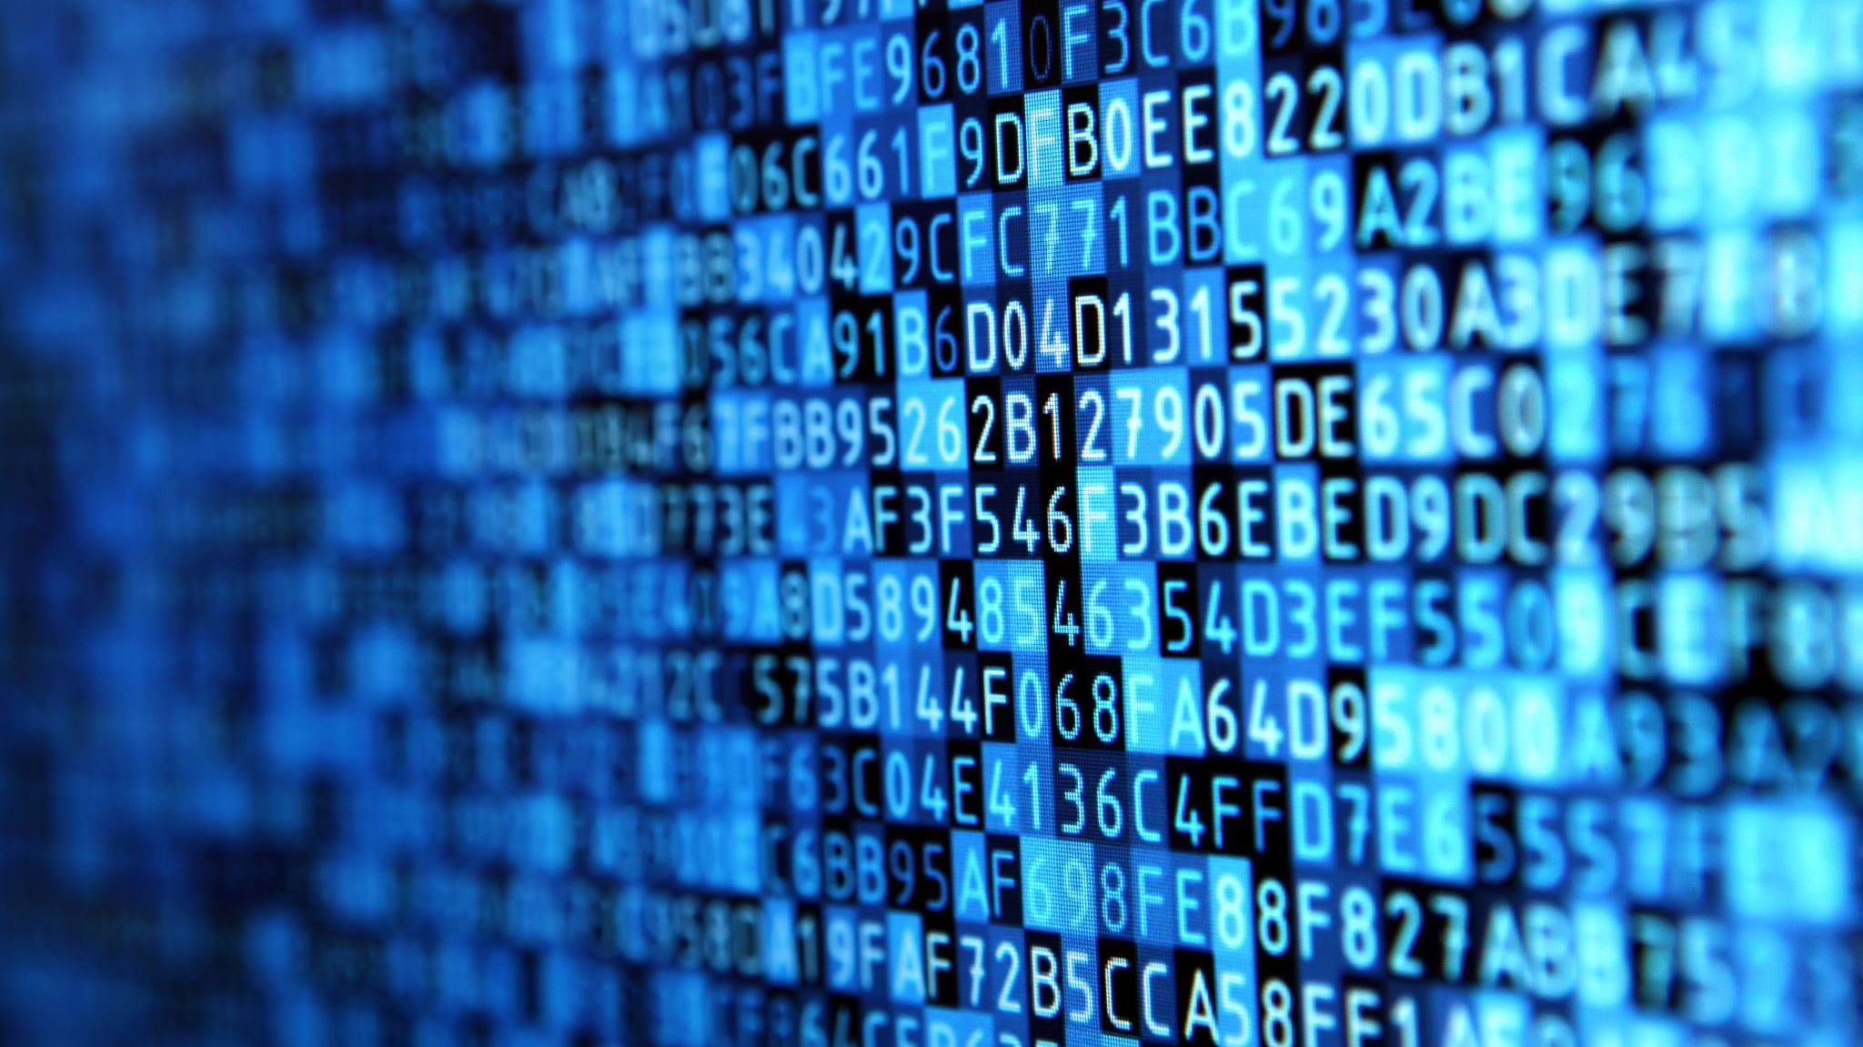
Business Information Systems
SOFTWARE ENGINEERING
SPRING 2021

Slide 2
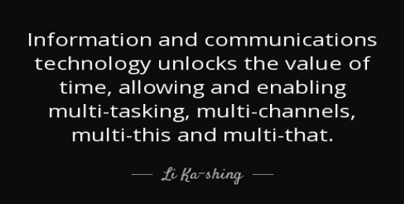

Slide 3
WHAT IS SYSTEM?
A system can be defined as a collection of interrelated components that work together towards a collective goal.
The function of a system is to receive inputs and transform these into outputs

Slide 4
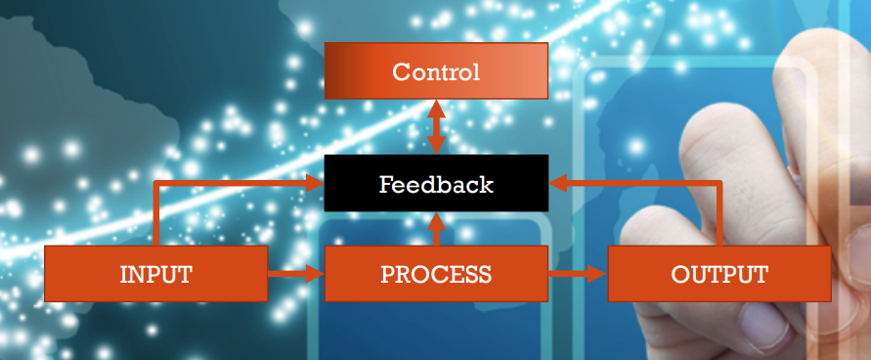

Slide 5
Information systems (is)
Information system, an integrated set of components for collecting, storing, and processing data and for providing information, knowledge, and digital products.
An information system is software that helps you organize and analyze data.

Slide 6
The purpose of is
Businesses use information systems
To make sound decisions
To solve problems
Problem is any undesirable situation
Decision arises when more than one solution to problem exists
Problem solving and decision making require information
Keys to success in business are
Gathering correct information
Storing information
Using information

Slide 7
Data, Information, and Information Systems
“Data”, “information” and “system” are commonly used terms
Important to understand their similarities and differences

Slide 8
Data vs. Information
Data: a given or fact
Can be number, statement, or picture
Information: facts or conclusions that have meaning within context
Composed of data that is manipulated

Slide 9
Data Manipulation
Data is manipulated to make useful information
Survey is common method of collecting data
Raw data is hard to read
Information is more useful to business than data

Slide 10
Generating Information
A process is manipulation of data
Process usually produces information
Process may produce more data
A piece of information in one context may be considered data in another context

Slide 11
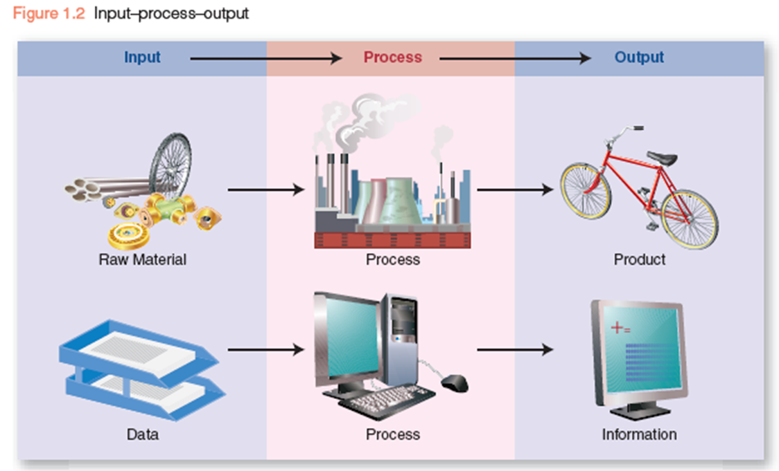
Generating Information

Slide 12
Information in Context
Not all information is useful
Useful information is
Relevant
Complete
Accurate

Slide 13
System Characteristics

Slide 14
COMPONENTS OF A SYSTEM
An information system is essentially made up of five components hardware, software, database, network and people.
These five components integrate to perform input, process, output, feedback and control.

Slide 15
ACTIVITY #1
What information systems might be found in your organization? For each system identify the people, hardware, communications, software and data resources involved. Also identify the type of relevant information produced by that information system and how does that help in decision making?

Slide 16
WHAT IS A BUSINESS INFORMATION SYSTEM?

Slide 17
WHAT IS A BUSINESS INFORMATION SYSTEM?
A business information system is a group of interrelated components that work collectively to carry out input, processing, output, storage and control actions in order to convert data into information products that can be used to support forecasting, planning, control, coordination, decision making and operational activities in an organization.

Slide 18
COMPUTER BASED BIS
An information system that makes use of information technology in order to create management (and/or business) information.

Slide 19
ADVANTAGES/DISADVANTAGES

Slide 20
BUSINESS APPLICATIONS OF BIS
Data processing: Handling the large volumes of data that arise from an organization's daily activities is described as data processing.
Transaction processing: Processing the sales and purchase transactions that an organization carries out in the course of its normal activities.
Process control systems: Systems which manage manufacturing and other production processes.

Slide 21
Usage and applications of computer-based information systems by organizational level (shading denotes usage of BIS)

Slide 22
CATEGORIES OF BUSINESS INFORMATION SYSTEM

Slide 23
E-BUSINESS SYTEMS
The process of using Web technology to help businesses streamline processes, improve productivity and increase efficiencies. Enables companies to easily communicate with partners, vendors and customers, connect back-end data systems and transact commerce in a secure manner. (IBM CEO Lou Gerstner, 1997)
The use of ICT, especially the Internet, to conduct business.

Slide 24
E-BUSINESS SYTEMS
e-Business is part of a broader Internet economy which encompasses all of the activities involved in using the Internet for commerce, which are consist of
Internet infrastructure layer
Internet application infrastructure layer
Internet intermediaries layer
Internet commerce layer
The benefits of e-business include reduced costs, improved efficiency and access to larger markets.

Slide 25
E-BUSINESS APPROACH

Slide 27
Thank you !! Best of luck….

